Slide 1
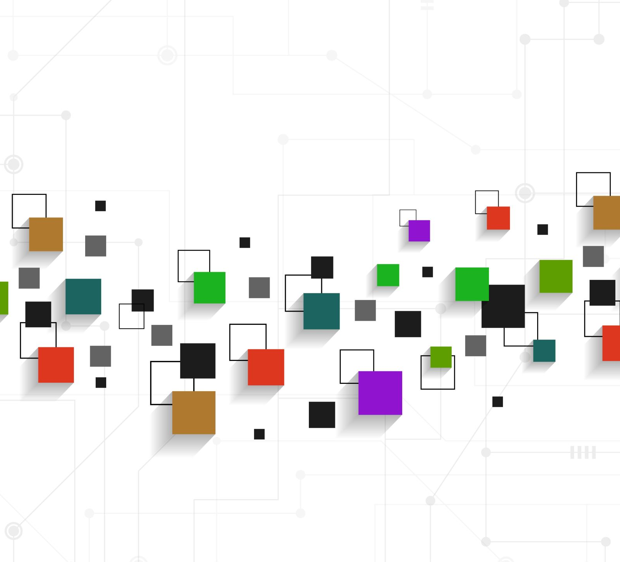

AUTISM HACKATHON ‘25 USE CASE 5:
XR JOB TRAINING SIMULATION
April 2nd – April 3rd

Slide 2
Executive Summary
Background/Situation
The Autism spectrum is very broad, and some people require more assistance than others to integrate with day-to-day activities. Job training is no exception. Our approach provides a way to learn new skills and tasks required to perform the job and be a part of the community. The solution can be used by the individuals as well as by Behavioural Specialists as an additional learning aid.
Solution
People with Autism are often visual thinkers. An extended reality solution teaches basic job skills and enables repetition of scenarios as many times as necessary, integrating seamlessly with the needs of the community and marketplace.
Benefits
Breaks tasks down into simple steps; physical performance of tasks increases learning outcomes.
Provides positive reinforcement to make training enjoyable in a safe environment.
Includes a range of sensory experiences - visual, auditory, and kinaesthetic. Further developments can add more personalization to meet the various needs of individuals.

Slide 3

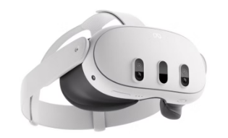


Goal: Job skill training using Extended Reality
Solution: Mixed Reality (XR) job training simulation designed to encompass full visual-verbal spectrum featuring integrated stakeholder reporting and supplemental resources
Immersive game-like training simulation
Individualized Education Progress (IEP) Reporting Tracking/Coordination with Support (Development Progress)
Visual Support Tools (cards)
Architecture Overview
Objective
Teach basic job skills to people with Autism using Extended Reality
Scenario
Set a table in a restaurant
Ensure the place setting is complete and properly arranged
3D Objects
Sketchfab
Deliver XR
Unity
Hardware
Quest 3 Headset*P
AI Audio
ElevenLabs
Prototype XR
ShapesXR

Slide 4
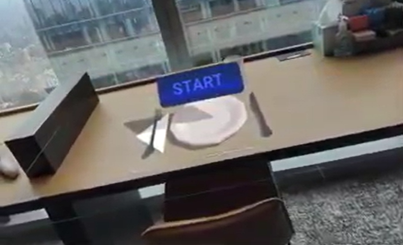
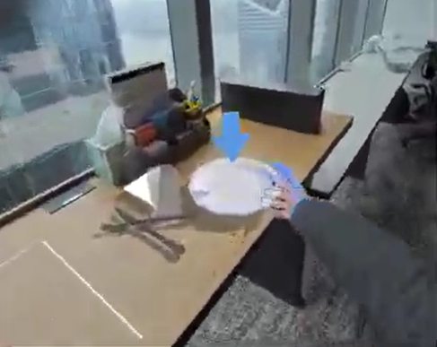
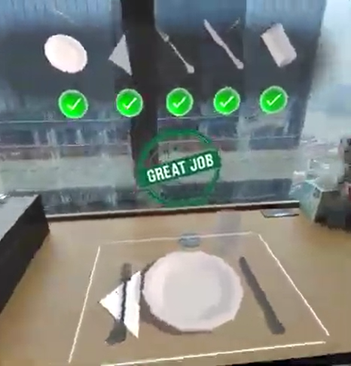
“Setting a Table” XR experience teaches users to setting a table in a game-like setting with visual & auditory cues, progress tracking, and positive feedback
The goal is for users to repeatedly practice correct place settings in a fun and engaging environment
Immersive simulation creates the opportunity for the user to see the correct table setting, then practice placing the objects in the correct places guided by object highlights, arrows, and audio prompts
Step-by-step visual progress tracker consists of “coins” and a picture of the target object (i.e., plate, napkin, glass, etc.) that light up when the task is completed correctly, complemented by positive audio feedback

Slide 5
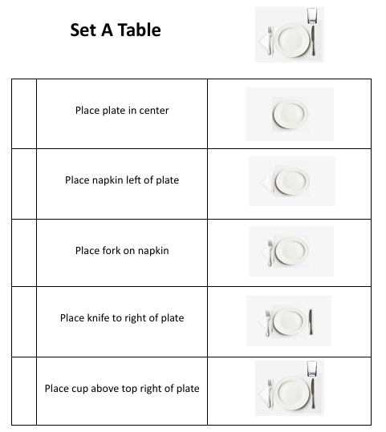
Support Infrastructure & Resources
Visual Behavior Support Cards
Complex social cues and expectations are distilled into simple, easy-to-understand visual prompts
Consistent and non-verbal way to communicate expectations, reducing confusion and anxiety
Behavior cue cards can help streamline communication, clarify expectations, and support employees who might struggle with certain aspects of their job
Individualized Education Progress (IEP) Reporting enables development progress transparency with users’ support system (FUTURE)
Store results in the cloud to show progress
Record session data to analyze/generate progression metrics
Measure time taken per action
Personalizing Recommendations and creating a custom learning track

Slide 6
Future State
Enhancements
Accessibility
Remove snap functionality and targets for guidance; allow unlimited opportunities (ShapesXR/Unity)
Increase the difficulty of social interactions (Unreal Engine)
Unified Access and Tracking across physical and social skills
Bundle multiple task boards
Create multiple immersive experiences for job relevant social skills (Unreal Engine)
Iterate the scenarios to increase complexity, while maintaining positive feedback for successful competition of each step
Incorporation of additional accessibility features to customize user experience based on individual needs, considering:
Physical Abilities
Deaf/deaf or Hard of Hearing
Blind or Low Vision
Processing Disorders - Language (LPD), Auditory (APD), or Sensory (SPD)

Slide 7



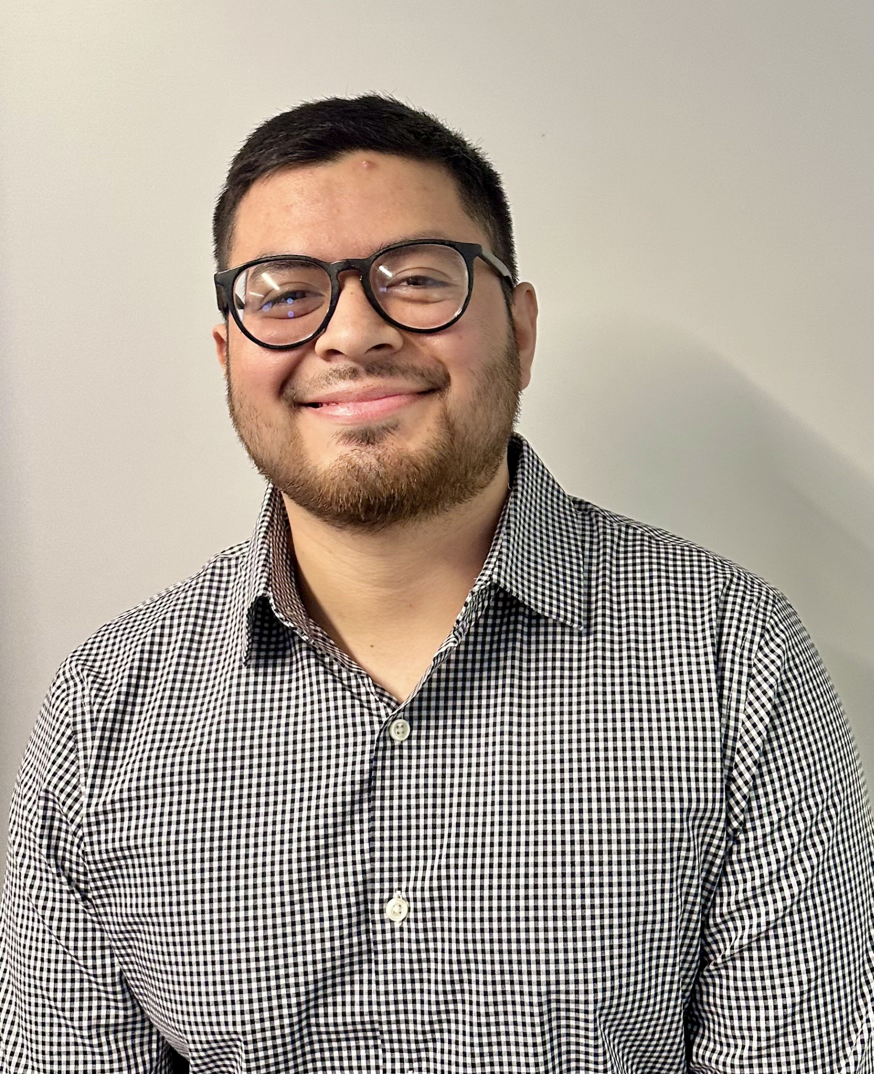


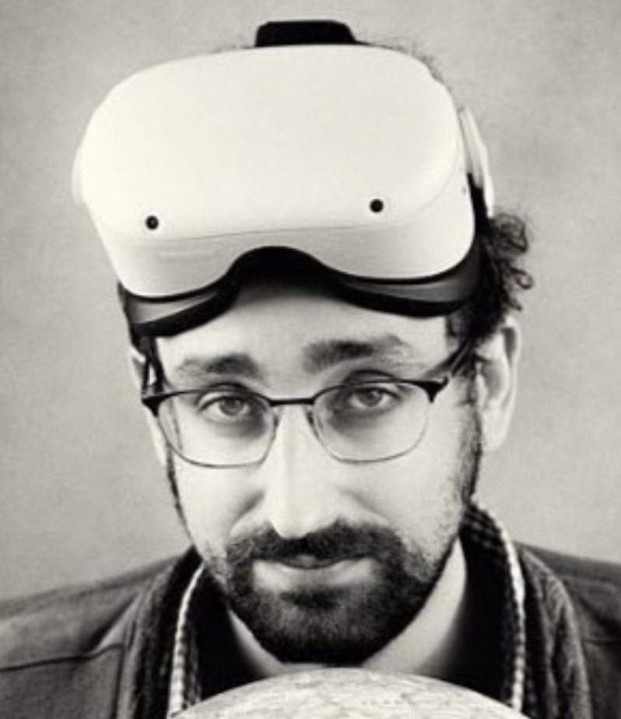
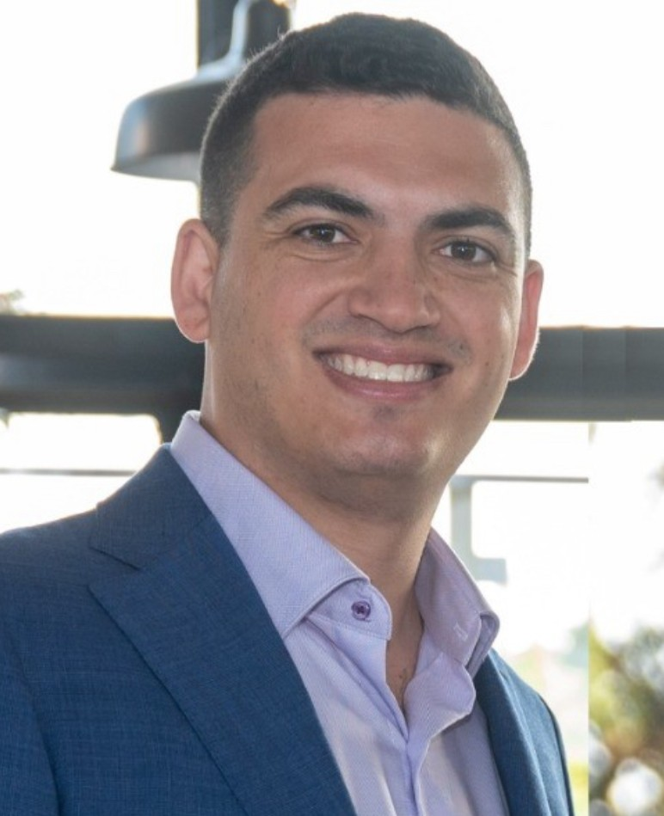

2025 Case 5 Team
Bethany Carlisle Morris
Morgan Stanley
Aysu Unal
Experiential Designer
Shannon Holmes
Morgan Stanley
Anthony Ovando
XR Developer
Jody Mitchell
Rebral1
Hillary Mercer
Morgan Stanley
Michael Markman
Head of Design
Jordan Lipton
Spatial Design
Yash Bhatnagar

Slide 8
Appendix A: MR Feedback For Table Setting: Error Correction Example
Error 1: Plate Too Far Right/Left of Center
Feedback: The plate is not centered. Ensure the plate is aligned with the middle of the table, creating equal space on both sides.
Correction Tip: "Visualize a line down the center of the table. Adjust the plate until it’s perfectly aligned in the middle.
Next Step: Once centered, proceed to place the napkin to the left of the plate.
Sound Prompts for Plate Alignment
Misaligned Plate (Error Sound):
Play a low-pitched buzz or an error tone when the plate is off-center.
Correct Placement (Success Sound):
Play a gentle chime when plate is centered

Slide 9
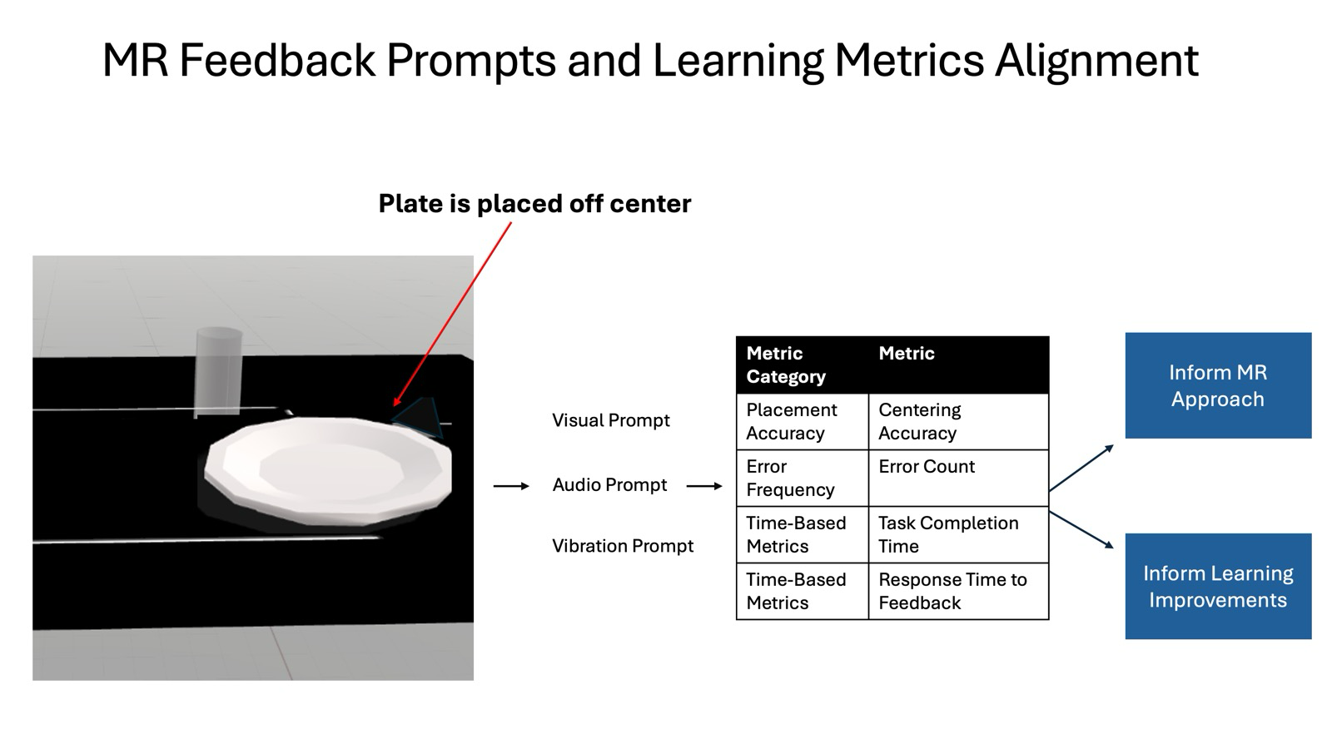
Appendix A: MR Feedback For Table Setting: Error Correction Example
Future iterations include additional levels of practice, allowing free placement of objects to further build skills.

Slide 10
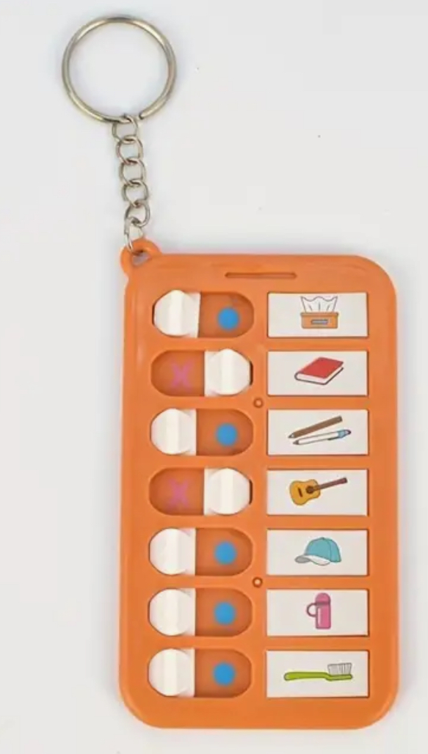






Appendix B: Future Enhancements
Create multiple mixed reality scenarios for physical job training tasks, with task boards to use while working (Shapes XR to Unity)
Set a cafe table
Prepare a to go order
Roll silverware
Refill condiments
Operate the point of sale system (use Toast retail iPad user interface)
Create multiple immersive experiences for job relevant social skills (Unreal Engine)
Iterate the scenarios to increase complexity, while maintaining positive feedback for successful competition of each step
ShapesXR/Unity - Remove snap functionality and targets for guidance; allow unlimited opportunities
Unreal Engine - Increase the difficulty of social interactions
Unified Access and Tracking across physical and social skills
Bundle multiple task boards into a set and/or employ tracking implements for completion visual reminders to aid in execution

Slide 11
Appendix C: Future Enhancements - Accessibility
Ability to select a voice (female voices tend to have higher sounds and male voices tend to be lower, some people may respond better or remember better if one or the other)
Possible sound effects - Sensory Input - (can turn on or off as per personal needs)
Clapping at end of task
A “ding” or some sound to signal correct placement of an item
Theremin - that plays different tones the closer the item is to the correct spot - providing auditory feedback in real time (almost like “hot” / “cold”)
Screen reader accessible (for visual impairments) OR all text with playable narration (e.g. can have sandwich toppings or menu items read aloud, if chosen)
Consider high contrast option
Consider colorblindness
Ability to magnify
Text for individuals who process textual-based information better
Icons for individuals who process visual-based information better
Ability for hiding visual noise
Blurring background or simplified background
Ability to display one step at a time OR show all steps

Slide 12
Appendix D: Future Enhancements & Additional Context
Arriving at Work
Greeting people at work
Signing / clocking in at start of day / shift
Arriving at Work - Preparing to Work
Health & Safety - wear / uniform - tie long hair back (or hat / hair net), change shoes if needed (e.g. if warehouse, may have steel-toed boots), ear protection / headset with microphone, gloves
Dealing with things to wear that may not be part of non-work day routines, materials that may cause sensory issues, etc
Health & Safety - washing of hands, personal habits
Personal Gear - ear protection
End of Day / Shift
Clocking out
Saying Goodbye to colleagues
Outside work
Knowing your schedule
Making sure uniform and tools are kept clean and presentable
Starting a new job
doing training
learning the new work environment
meeting colleagues / managers
learning key information (e.g. if sick how to report, holiday info, hours open, normal schedule / routines at work, policies and procedures)
Providing personal information (e.g. Pay details (and getting paid), Emergency contact details, etc.)
Breaking work routines - e.g. new managers or colleagues joining, if menu or shop items change, getting new tools / machines, if job responsibilities change, etc.

Slide 13
Appendix D: Future Enhancements & Additional Context
At Work
Handling items, hardware, etc at work - using the right machines and tools for the job
Folding a napkin
Putting items in a bag
Putting items on a tray
Putting items on a shelf
Using the cash machine to enter order and get a total amount of money due
Using cash machine and collecting amount due (counting amount)
Using cash machine and giving change (counting out)
Using debit machine to collect payment
Giving refunds - Cash
Giving refunds - Card Payment
Making a sandwich / sub (order)
Keeping work space clean / clear
Health & Safety - cleaning up messes / spills
Emergency Procedures - Fire Drill, Leaks, etc.
Interacting with colleagues or customers
Greeting customers
Taking orders
Dealing with conflict at work (e.g. irate customers, things not working properly or going to plan, etc.)
Raising issues to manager
Dealing with Injury or Sickness
Small Injury - e.g. needing a bandaid or Ice
Larger Injury - e.g. hospital visit
Sickness
At Work - Staff Meetings

Slide 14


